Slide 1

Department of Data science
II B.Tech II Semester Mini Project-2024
Submitted by
Batch -03
EDUTECH ANALYSIS
Guide Supervisor: Mrs. Y.Anjali
Assistant Professor, Department of Data Science
22R21A6759 URITI NAGA PARDHIV SURESH
22R21A6707 CHEPURI SHESHU
22R21A6755 SURAJ KARNE
23R25A6702 GUNDARAM SAMPATH YADAV

Slide 2
Contents
Abstract
Mission Vision
Introduction
Problem Statement
Proposed System
Requirements
Literature Survey
Action Plan
Implementation
Conclusion
Advantages
References

Slide 3
Abstract
Pardh Tech: A company with expertise in business decision making for software companies. They offer various analysis services.
EduTech: A company providing paid and free courses to equip students with skills for the competitive corporate world. They’re looking to focus on courses related to 4.0 technologies (technologies like Artificial Intelligence, Blockchain, etc.).
The Initiative: EduTech plans to launch these new 4.0 tech courses within the next 8 months, coinciding with their 25th-anniversary celebrations.

Slide 4
Mission
Vision
To leverage data analysis to gain a deeper understanding of student interest in 4.0 technologies and preferred learning styles within the EduTech landscape.
To translate these insights into actionable recommendations for developing engaging and effective educational courses that cater to the evolving needs of the student population.
To contribute to a future where EduTech platforms are personalized and optimized based on student data, fostering a more effective and engaging learning experience for all.
To empower EduTech company with data-driven insights that enable them to tailor their teaching methods to individual student strengths and preferences.
To contribute to a more accessible and inclusive educational landscape by leveraging the power of 4.0 technologies.

Slide 5

Introduction
PardhTech represents a company that assists software companies in making business decisions through a range of analytics services.

Slide 6
Potential areas where PardhTech can assist EduTech:
Market Analysis: PardhTech’s analysis services can help EduTech identify the most in-demand 4.0 tech skills within the software industry. This will ensure their courses target the right areas and provide students with the most relevant skill sets.
Course Development: Pardh Tech can analyze existing learning materials and competitor courses to help EduTech develop high-quality and engaging course content.
Pricing Strategy: Pardh Tech’s expertise can be valuable in determining the optimal pricing strategy for EduTech’s courses, considering factors like target audience, competition, and course value.
And in more parameters…

Slide 7
Problem Statement
Traditional methods of assessing student understanding and perspectives are often time-consuming and lack real-time insights.
This project aims to address this by developing a system to collect and visualize real-time data on students' attitudes towards and experiences with 4.0 technologies in education.
The goal is to gain a deeper understanding of student needs and preferences, enabling the creation of more engaging and effective learning experiences that leverage 4.0 technologies. The problem statement highlights the limitations of current methods, the project's purpose of real-time data collection and visualization, and the ultimate goal of improving educational experiences.

Slide 8
Proposed System
Our Approach:
Data Collection & Analysis: We partner with educational institutions to collect student data through surveys and assessments. Our team of data analysts then cleans, analyzes, and interprets this data to identify trends and patterns in student interests and learning preferences.
Actionable Insights: Based on the data analysis, we provide educators with actionable recommendations for curriculum development and instructional delivery. This might include:
Identifying high-demand domains within 4.0 technologies (e.g., AI, Cybersecurity) and creating focused courses.
Recommending teaching methods aligned with student learning styles (e.g., hands-on projects for students who prefer practical application).
Developing personalized learning pathways based on individual student strengths and weaknesses.

Slide 9
Requirements
Software:
Survey creation: Google Forms
Data storage and analysis: Oracle Database (SQL)
Data visualization: Microsoft Power BI
Document creation and collaboration: Google Docs
Hardware:
Minimum requirements: 4 computers with internet access
.

Slide 10
Literature survey

Slide 11
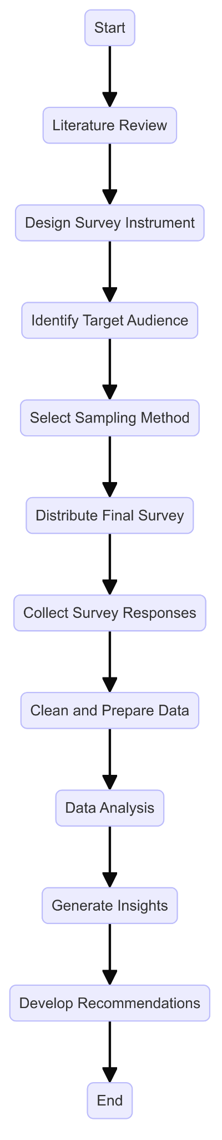
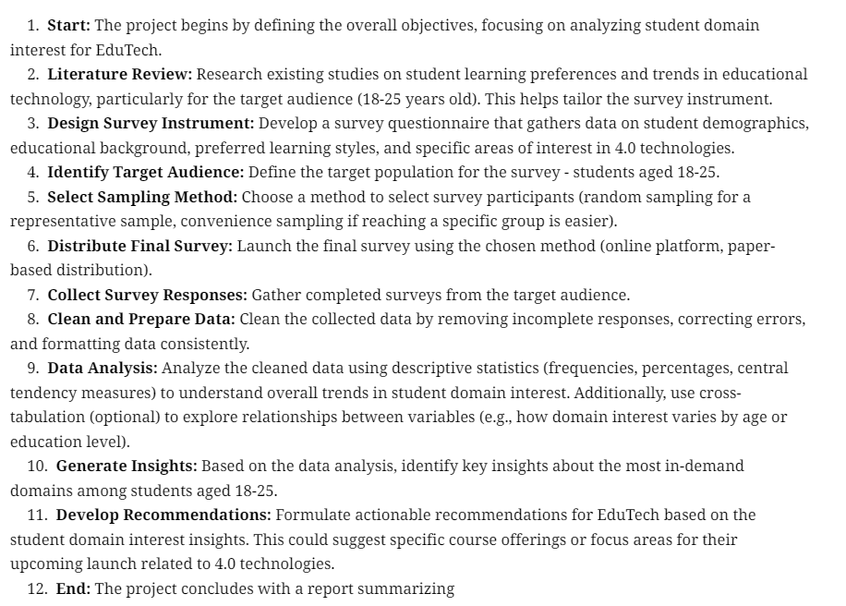

Slide 12
Action plan(7 weeks)
Define research goals and scope.
Identify key technologies (AI, IoT, Big Data).
Gather information from academic papers and industry reports.
Choose data collection methods (e.g., surveys, interviews).
Develop data collection tools (e.g., questionnaires, interview guides).
Collect data and clean it for analysis.
Week 1
1
Research
2
Week 2-4
Data Collection & Cleaning
Analyze data trends and relationships using descriptive statistics.
Identify initial insights.
Week 5
3
Analyze existing research on 4.0 technologies.
Create visualizations (charts, graphs) to support findings.
Refine research focus based on combined data.
Develop comprehensive conclusions and recommendations.
Prepare a final report or presentation.
Primary Data Analysis
Week 6-7
4
Secondary & Final Insights

Slide 13
Implementation

Slide 14
PROJECT JOURNEY FOR REAL-TIME STUDENT DATA ON
4.0 Technologies in Education

Slide 15




INITIATION AND PLANNING Define project goals and objectives Identify target audience Choose real-time data collection tools Prepare data analysis and visualization methods
DEVELOPMENT AND IMPLEMENTATION Pilot test Refine tools and questions Collect real-time student data
ANALYSIS AND REPORTING Organize and clean data Analyze data Visualize data Prepare a project report
ACTION AND IMPROVEMENT Evaluate and iterate Develop action plan Implement improvements

Slide 16
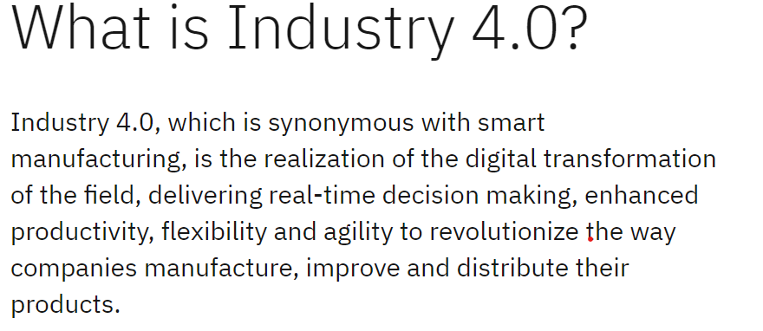
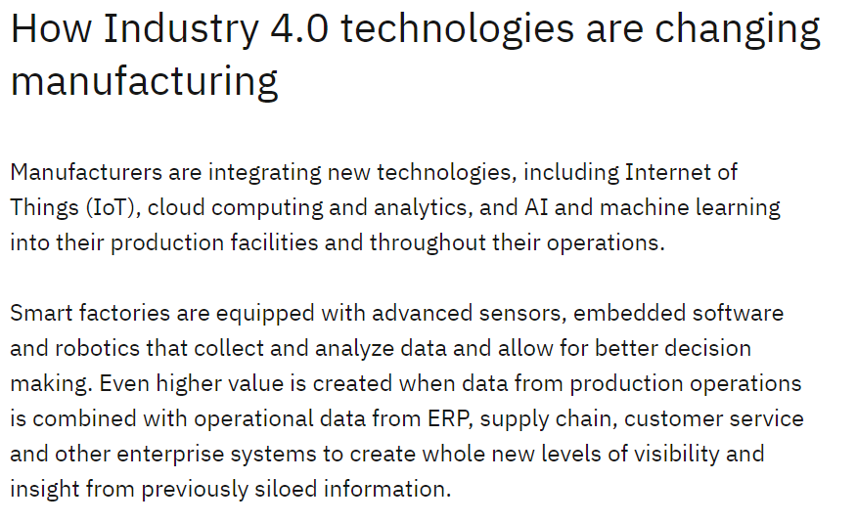
Research
Finalised domains:
Artificial Intelligence
Data Science
Embedded systems and IoT
Big Data Analytics
Cloud Computing
Cyber Security

Slide 17
DEVELOPED SURVEY :
The survey you're developing in this project focuses on collecting real-time data from students to understand their attitudes towards and experiences with 4.0 technologies in the educational setting.
Student Awareness: Gauge how familiar students are with different 4.0 technologies like Artificial Intelligence (AI), Virtual Reality (VR), and Augmented Reality (AR).
Student Perceptions: Uncover student opinions on the potential benefits and challenges of using 4.0 technologies for learning.
Comfort Level: Assess student comfort and potential concerns regarding the use of AI or immersive technologies like VR/AR in the classroom.

Slide 18


DATA COLLECTION METHODS:
In our journey to gather meaningful insights and drive informed decisions, we've embraced the power of digital tools like Google Forms and spreadsheets. These tools have not only streamlined our data collection process but have also empowered us to develop deeper into understanding our audience, stakeholders, and organizational dynamics.
GOOGLE FORMS: Free and easy to use, integrated with Google Workspace (formerly G Suite). It allows you to create surveys and analyze responses directly in Google Sheets
SPREADSHEETS: we used spreadsheets for data collection as we know Spreadsheets is a powerful tool created by humans to organize, manipulate, and analyze data efficiently.

Slide 19
Data collection
Data Cleaning

Slide 20
DATA CLEANING AND PREPARATION:
Data Preparation Steps(using spreadsheets)
Identifying and Removing Duplicates
Removing of unwanted columns
Checking for Missing and Null Values
Handling Missing and Null Values
Data Type Consistency

Slide 21
Data cleaning
Primary Data Analysis

Slide 22
PRIMARY DATA ANALYSIS(USING SQL)
1. Distribution of College
2. Gender Breakdown
3. Year of Study
4. Interest in Specific Domains
5.minimum,maximum,standard deviation

Slide 23
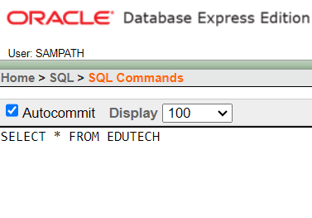

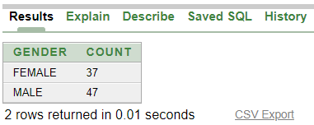
This are the some output we have get from our
PRIMARY DATA ANALYSIS(USING SQL)
Gender Breakdown

Slide 24
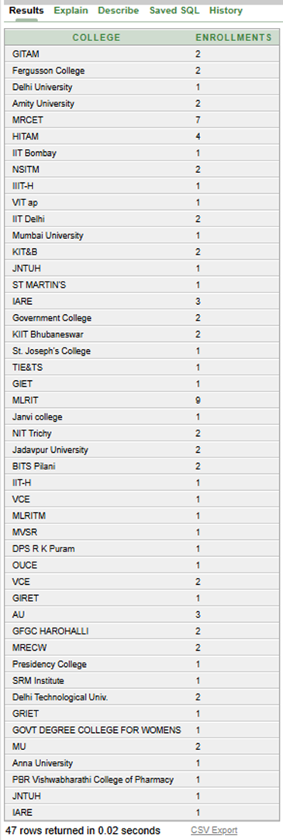
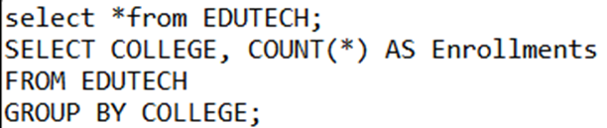
DISTRIBUTION OF COLLEGE :

Slide 25
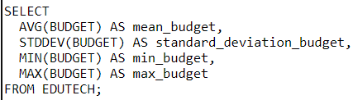
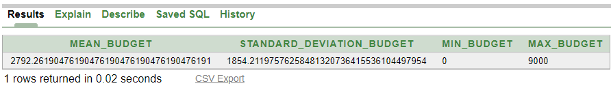

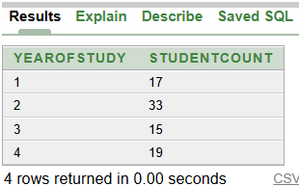
Minimum,maximum,standard Deviation :
Year of Study :

Slide 26

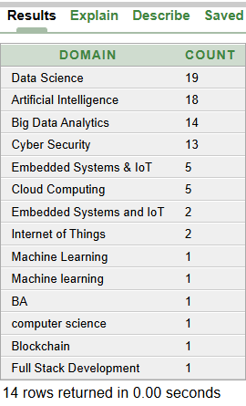
Interest in Specific Domains :

Slide 27
Primary Data Analysis
Secondary Data Analysis

Slide 28

SECONDARY DATA ANALYSIS
In our project, a secondary analysis would involve taking the real-time data we collected from students (through our survey) and analyzing it further to extract deeper insights. This analysis would happen after we already compiled and cleaned the initial data set and completed primary analysis.

Slide 29
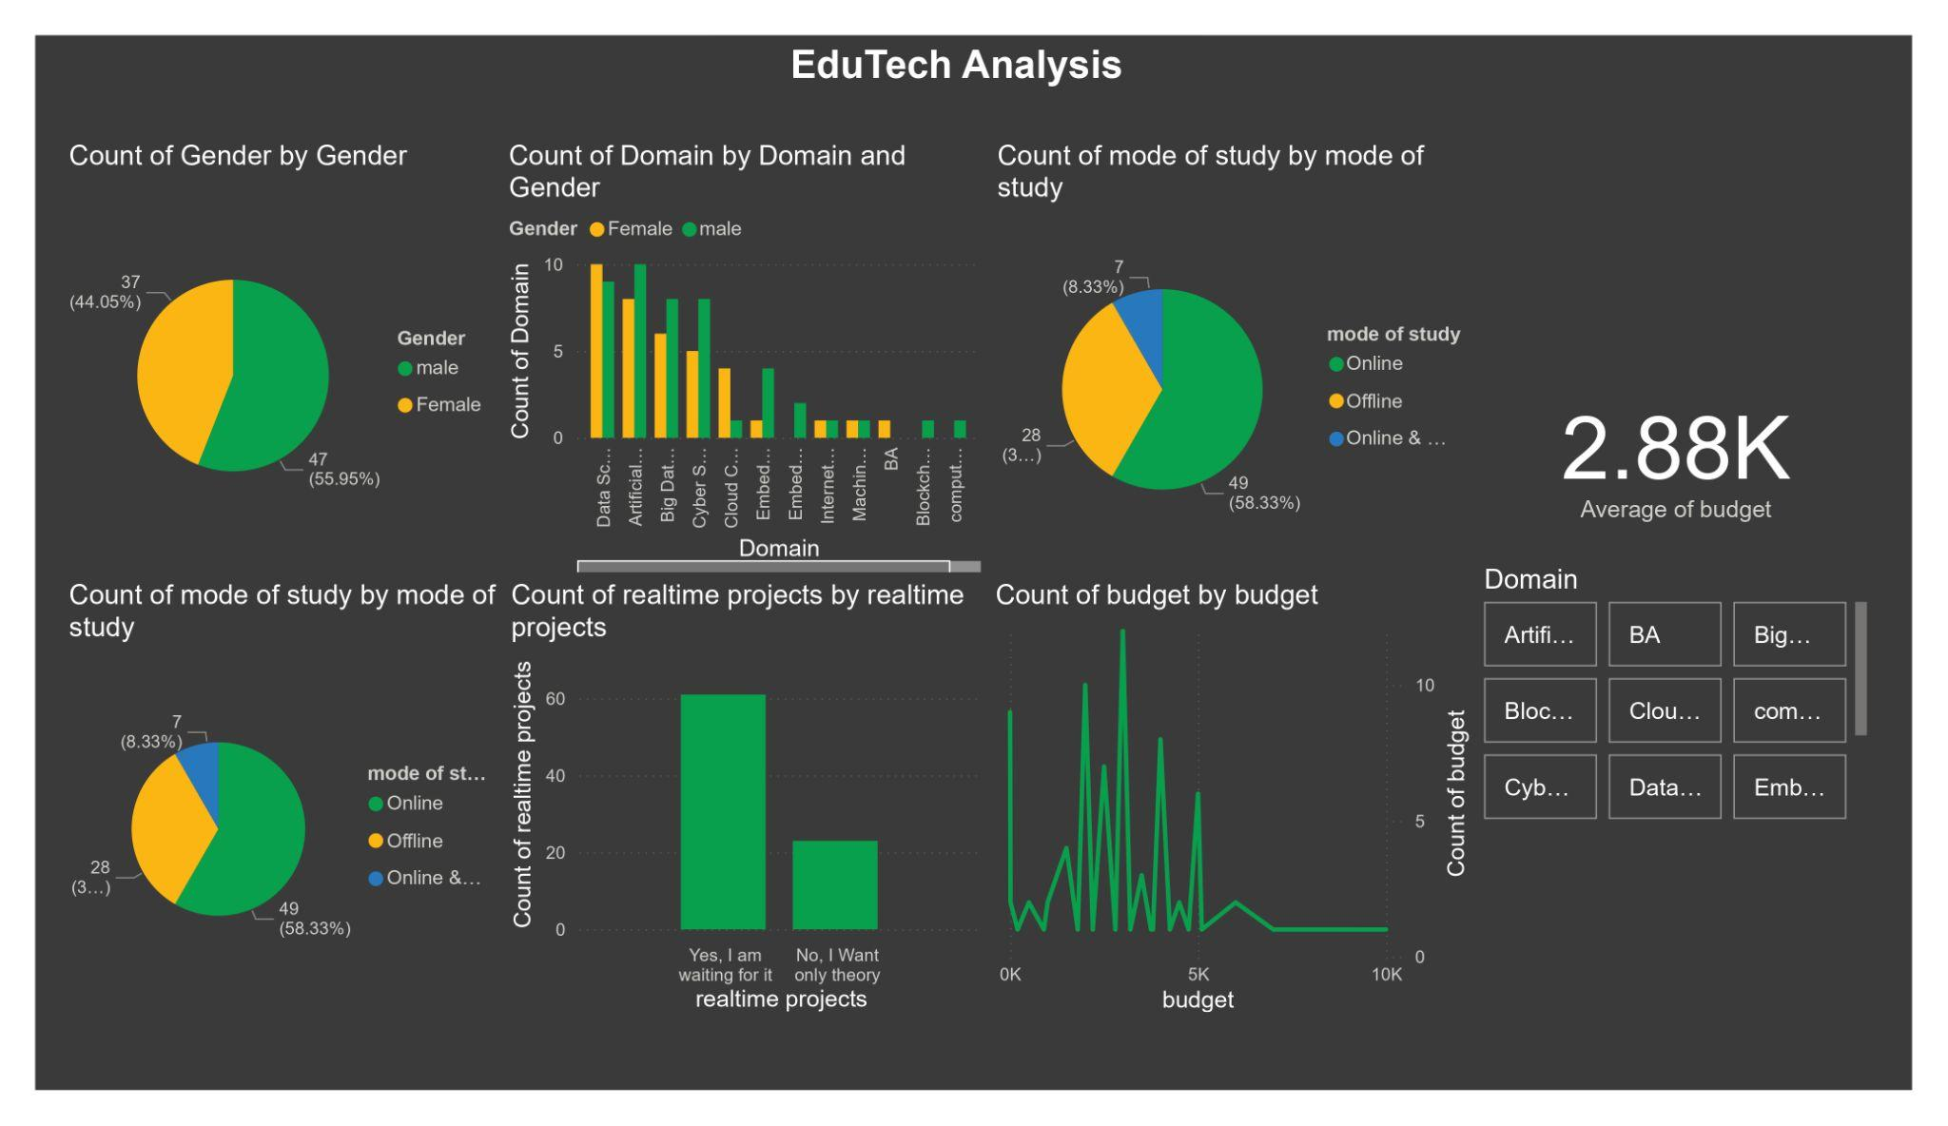
Power BI:
Power BI is a powerful business intelligence tool from Microsoft.
It allows you to import your data set (e.g., from Excel), create visualizations, and explore trends and patterns within the data.
For your project, Power BI can be a great tool for conducting the secondary analysis of student responses.
DATA VISUALIZATION USING POWER BI

Slide 30
Focus Area plots :
This Section contains of:
1. Focuses on questions in survey
2. Findings from plots
3. Suggestions for EduTech company

Slide 31
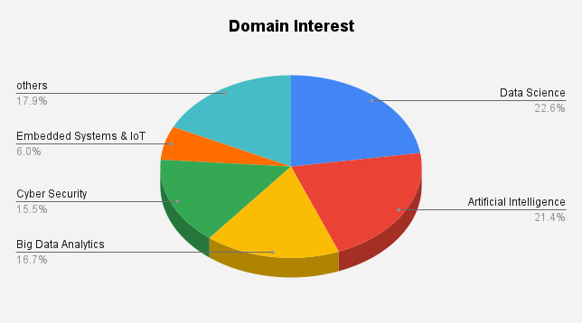
Which Domain are you interested in ?
Findings
Data Science and Artificial Intelligence are the clear frontrunners in terms of student interest, together constituting nearly 45% of the total interest.
Cybersecurity and Big Data Analytics follow closely behind, indicating a significant interest in these domains as well.
Embedded Systems and IoT and Others have relatively lower interest levels, suggesting a potential need for further exploration or targeted marketing efforts.
Suggestions
Prioritize Course Development: Given the high interest in Data Science and Artificial Intelligence, it is recommended to prioritize the development of courses in these domains.
Expand Offerings: While Cybersecurity and Big Data Analytics show substantial interest, offering courses in these areas could further attract students.
Targeted Marketing: Develop focused marketing strategies to promote the less popular domains, potentially highlighting their career prospects and unique learning opportunities.

Slide 32
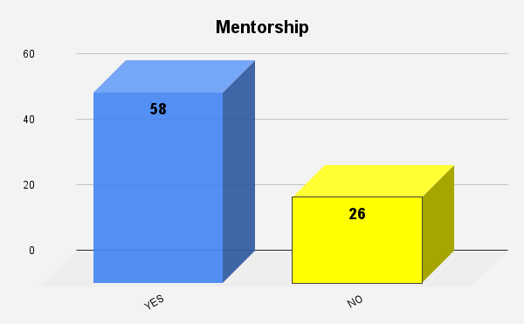
Would you like one-on-one mentorship from industry professionals?
Findings
High Demand for Mentorship: A significant majority (58 out of 84 respondents) indicated a desire for mentorship, underscoring the importance of mentorship programs.
Minority Preference for Independent Learning: While a considerable portion of respondents expressed a need for mentorship, a notable minority (26 out of 84) indicated a preference for independent learning.
Suggestions
Prioritize Mentorship Programs: Given the high demand, a robust mentorship program should be a cornerstone of the educational or professional development initiative.

Slide 33
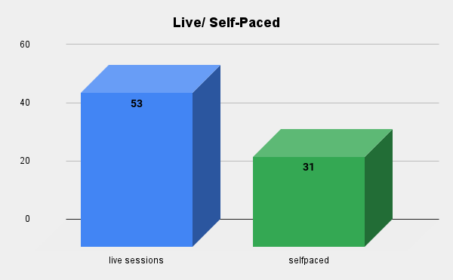
Would you like to enroll in the program?
Live Session/ Self-paced
Findings
Stronger Preference for Live Sessions:
The bar representing live sessions is significantly taller than the one for self-paced learning, indicating a stronger preference for live sessions among the respondents.
Suggestions
Prioritize Live Sessions: Invest more resources and efforts in providing high quality live sessions, ensuring they are engaging and interactive.
Supplement with Self-Paced Options: While live sessions are preferred, offering self-paced learning materials as supplementary resources can cater to a wider audience and provide flexibility.

Slide 34
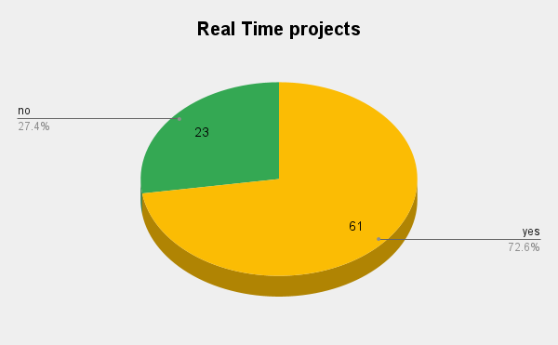
Are you interested to learn by solving real-time simulations?
Findings
High Prevalence of Real-Time Project Experience: A significant majority of respondents (72.6%) have been involved in real-time projects, indicating a strong emphasis on real-time systems development within the surveyed group.
Smaller Segment with No Experience: A smaller portion (27.4%) of respondents have no experience with real-time projects, suggesting potential areas for skill development and training
Suggestions
Leverage Real-Time Expertise: Organizations should capitalize on the existing expertise in real-time systems by assigning experienced individuals to mentor and guide those with less experience.
Skill Development Focus: Provide opportunities for individuals with no real time project experience to gain exposure and develop necessary skills through training, workshops, or small-scale projects.
Project Prioritization: When allocating resources and personnel, prioritize projects that require real-time capabilities to optimize the utilization of existing

Slide 35
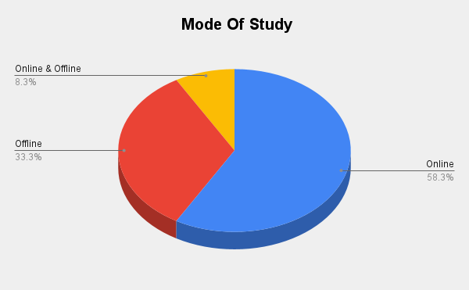
How you Want to study?
Findings
Online Learning Dominance: Online learning is the most preferred mode of study, accounting for 58.3% of respondents.
Offline Learning Still Relevant: Despite the dominance of online learning, offline learning still holds significance, with 33.3% of respondents opting for this mode. •
Blended Learning Niche: A smaller segment of respondents (8.3%) prefers a combination of online and offline learning, indicating a potential demand for flexible learning options.
Suggestions
Prioritize Online Learning Infrastructure: Given the strong preference for online learning, institutions should invest in robust online platforms and resources to ensure a seamless learning experience.
Complement with Offline Support: While online learning is preferred, offering offline support systems like physical libraries, study centers, or mentorship programs can enhance the overall learning experience.

Slide 36
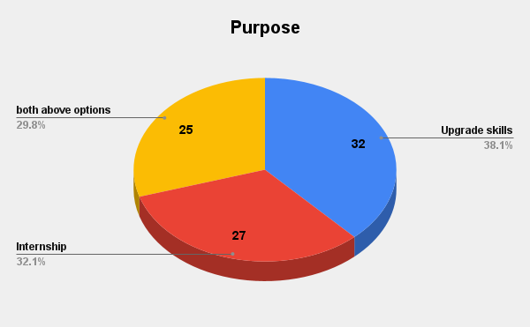
Expectations From Course
Findings
Skill Enhancement is Primary: The largest segment of participants (38.1%) aims to upgrade their skills, indicating a strong desire for professional development.
Balanced Interest: Both ’Internship’ and ’Both Above Options’ hold substantial weight, with 32.1% and 29.8% respectively, suggesting a balanced interest in practical experience and skill enhancement
Suggestions
Skill Enhancement Focus: Given the significant emphasis on skill upgrade,the workshop content should heavily prioritize practical skill development and application.
Internship Opportunities: To cater to the interest in internships, exploring partnerships with companies for potential placements or projects can be beneficial.

Slide 37
Conclusion
Consists of:
Key Findings
Recommendations
Summary

Slide 38
Key Findings
Strong preference for live sessions: Respondents overwhelmingly favored live learning formats over self-paced options.
High demand for mentorship: A significant portion of participants expressed a need for mentorship to support their learning journey.
Focus on skill enhancement: Upgrading existing skills was the primary motivation for workshop attendance.

Slide 39
Recommendations
Prioritize live learning experiences: Invest in technologies and infrastructure to deliver high-quality live sessions.
Offer flexible options: While live sessions are preferred, provide self-paced resources for supplementary learning.
Implement mentorship programs: Establish a robust mentorship program to support learners and address the expressed need.
Skill-focused curriculum: Design workshops and programs with a strong emphasis on practical skill development and application.

Slide 40
Summary
Student interest in 4.0 technologies leans heavily towards Data Science and Artificial Intelligence, followed by Cybersecurity and Big Data Analytics.
There’s a clear preference for live learning formats over self-paced options.
A significant portion of respondents expressed a need for mentorship,indicating the potential for a robust mentorship program.
To maximize the impact of educational initiatives, a focus on these high-demand domains, coupled with a balance of live and self-paced learning options and mentorship opportunities, is recommended.

Slide 41
Advantages
Technical Expertise
Data Analysis (SQL, etc.)
Gain hands-on experience in data cleaning, analysis techniques, and writing SQL queries - highly sought-after skills in the industry.
Tool Proficiency Develop proficiency in using industry-standard tools like SQL, Power BI, and Excel for data manipulation, analysis, and visualization.
Data Science Simulation
Project Mimics Real-World Work
Clean, analyze, and interpret real-time survey data, mimicking the core tasks undertaken by data scientists in various industries
Soft Skills Development
Teamwork and Communication Develop effective collaboration skills, foster improved communication, and practice project planning and task delegation.
Project Management Gain practical experience in the fundamentals of project management, including planning, execution, and monitoring.

Slide 42
References
[1] Bannon, W. M. ”The 7 steps of data analysis.” New York: Stats Whisperer (2013).
[2] Javaid, Mohd, et al. ”Understanding the adoption of Industry 4.0 technologies in improving environmental sustainability.” Sustainable Operations and Computers 3 (2022): 203-217.
[3] Khan, Syed Abdul Rehman, Arsalan Zahid Piprani, and Zhang Yu. ”Digital technology and circular economy practices: future of supply chains.” Operations Management Research 15, no. 3 (2022): 676-688.
[4] Fink, Arlene. How to analyze survey data. Vol. 8. Sage, 1995.
[5] Couper, Mick P. ”Technology trends in survey data collection.” Social Science Computer Review 23, no. 4 (2005): 486-501.
[6] Rojko, A. (2017). Industry 4.0 concept: Background and overview. International journal of interactive mobile technologies, 11(5).

Slide 43


